Slide 1

Policemen’s Annuity & Benefit Fund of Chicago
Report to the
Illinois Senate Special Committee on
Pension Investments Hearing
December 10, 2020
Presenters:
Thomas Beyna, Board President, PABF
Erin Keane, Executive Director, PABF
Kevin Leonard, Managing Partner, NEPC
DeAnna Jones, Senior Consulting Specialist, NEPC Kristen Finney-Cooke, Senior Consultant, NEPC

Slide 2

FUND OVERVIEW
PABF Diversity Commitment
PABF supports diversity and equal opportunity in all aspects of fund operation. We are committed to having staff, service providers and an investment portfolio that represents a variety of backgrounds, perspectives, and skills. We believe that the more inclusive we are, the better it is for our members and our community.
FUND ASSETS
FUND PARTICIPANTS
ACTIVE PARTICIPANTS
Assets
Unfunded Liabilities
Funding Ratio
$2.6 billion
$11 billion
22%
Active
Annuitants
Total
13,353
13,213
26,566
African American
Latinx
Asian American
Caucasian
Other
Women
20%
28%
3%
47%
2%
23%
*PABF is a severely underfunded pension plan.
*Insufficient contributions to the plan forces PABF
to sell assets to make benefit payments and restricts
investing capabilities.
Policemen’s Annuity & Benefit Fund of Chicago
1

Slide 3
FUND OVERVIEW CONT.
EMPLOYEES & TRUSTEES
70% of the Fund’s Staff are women and people of color 38% of the Fund’s trustees are women and people of color
SERVICE PROVIDERS
4 of the 11 external services providers for the fund are women and people of color*
INVESTMENT CONSULTANT
50% of the Fund’s investment consultant client team are woman and people of color
*Excludes investment related service providers (i.e. investment managers, custodian, brokers and investment consultant)
Policemen’s Annuity & Benefit Fund of Chicago
2

Slide 4
MWDBE GOALS
Diverse Investment Manager Goals
ASSET CLASS
Equities
Fixed Income
Alternatives (Real Estate, Private Equity, Hedge Fund, Opportunistic Credit)
TARGET RANGE (% of asset class)
11-13%
5-15%
4-5%
CURRENT ALLOCATION
8%
39%
25%
The Board reviews MWDBE goals annually.
The Board increased the Fixed Income goal from 3-11% to 5-15%.
Allocations to MWDBE alternative investment managers continues to exceed the Fund’s goal.
Policemen’s Annuity & Benefit Fund of Chicago
3

Slide 5
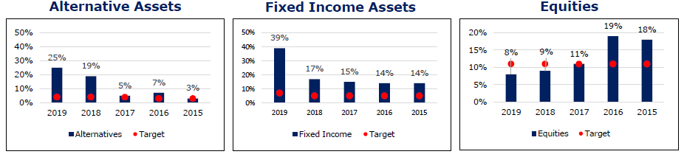
MWDBE GROWTH
Five Calendar Year Diverse Asset Growth by Asset Class
Policemen’s Annuity & Benefit Fund of Chicago
4

Slide 6
MWDBE MANAGED ASSETS
EQUITIES | % OF ASSETS | $ VALUE OF ASSETS
African American | 19% | $89 m
Women | 7% | $32 m
FIXED INCOME | % OF ASSETS | $ VALUE OF ASSETS
African American | 21% | $100 m
Latinx | 21% | $100 m
ALTERNATIVES | % OF ASSETS | $ VALUE OF ASSETS
African American | 8% | $40 m
Latinx | 3% | $16 m
Women | 20% | $95 m
18% of total Fund assets and $472 million is actively managed by diverse firms.
Policemen’s Annuity & Benefit Fund of Chicago
5

Slide 7
MWDBE FEES
MWDBE STATUS
African American
Latinx
Asian American
Female
% OF TOTAL FEES PAID
9%
1%*
0%
9%
*The percentage does not fully reflect a $100 million core fixed
income mandate funded to a Latinx firm in late 2019.
  100% of the Fund’s MWDBE allocation is actively managed.
  This results in higher fees paid to MWDBE managers.
  19% of the Fund’s total fees paid went to MWDBE firms, an increase of 6% from the previous year.
Policemen’s Annuity & Benefit Fund of Chicago
6

Slide 8
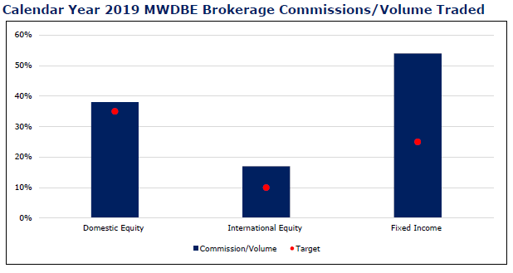
MWDBE BROKERAGE
ASSET CLASS | GOALS | ACTUAL
Domestic Equity | 35% | 38%
International Equity | 10% | 17%
Fixed Income | 25% | 54%
The Fund continues to exceed its Brokerage target in each asset class.
Policemen’s Annuity & Benefit Fund of Chicago
7

